Slide 1
Graphics File Format
A graphics format file reader is responsible for opening a file, determining its validity and interpreting the information contained within it.
A reader may take its input , source image data either from a file or from the data stream of an input device, such as a scanner or frame buffer.

Slide 2
Graphics File Format
There are two types of reader designs:
i. Filter ii. Scanner.
A filter reads a data source one character at a time.
The Scanners randomly access across the entire data source. They can read and reread data anywhere within the file.
Filters require small amount of memory while the Scanners require a larger amount of memory.

Slide 3
Reading Graphics File Data
Image data are read from a Graphics File.
Compressed image data is read one byte at a time from file and into memory before it is decompressed.
Uncompressed image data is often stored only as bytes, even when the pixels are two three or four bytes in size.

Slide 4
Writing a Graphics File Data
Inverse of Reading a graphics file
Writers may send data directly to an output device, such as a printer or they may create image files and store data in them.

Slide 5
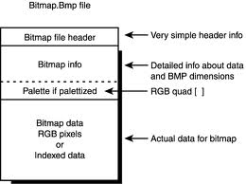
BMP
BMP
A Bitmap File (BMP) contains an exact pixel mapping of an image which can then be reconstructed by rendering application on the display surface of an output device.
BMP file consists of:
Header Bitmap Data Color Palette other Data

Slide 6
BMP
The Header
Consists of binary or ASCII format data located at the beginning of the file., but the information about the bitmap data is stored elsewhere in the file.
A Bitmap Header is composed of
i. File Identifier
A header starts with a unique identification value called a File Identifier, file IP or ID.
ID values are assigned arbitrarily by the creator of the file format, and can be a series of ASCII characters

Slide 7
BMP
ii. File Version
Successive version of bitmap formats differ in header size, bitmap data supported and color capability.
After verifying the file format, an application examine the version value, determine whether it can handle the image data located in the file.
iii. Bitmap Data
In many bit map files Bitmap Data is found immediately after the end of the file header.
Bitmap data is composed of pixel values.

Slide 8
BMP
Sequence of values that logically maps bitmap data in a file to an image on the display surface of an output device
Pixels on an output device are usually drawn in scan lines corresponding to rows spanning the width of the display surface.
Image data is usually first assembled in one or more blocks of memory.
Exactly how the data is arranged then depends on a number of factors, including the amount of memory installed, the amount available to the application, and the specifics of the data acquisition or file write operation in use.

Slide 9
TIFF
Acronym of Tag Image File Format
TIFF specification was intended for storing black and white images, created by scanners
There are three sections in a TIFF file:
- Image File Header (IFH)
- Image File Directory (IFD)
- Bitmap Data

Slide 10
TIFF
Image File Header is always at the beginning of the TIFF file, occupying the first eight bytes in every TIFF file.
IFH contains three fields of information
An identifier, used as byte order identifier and having a size of a word
A version , contains version number of the TIFF format.

Slide 11
TIFF
IFD offset is a 32 bit value. It is offset position of the first image file directory in TIFF file. We use this value to identify the starting position of the image file information
One way to verify whether the file is a TIFF file is by checking the first four bytes of the file
Image File Directory is used to describe the bitmapped data to which it is linked
It contains information of height , width, and depth of image colors and compression types used and doesn’t have a fixed size and position in a TIFF file

Slide 12
Run Length Encoding
An effort to reduce memory requirements in raster system , frame buffer is organized as a linked list and intensity information is encoded
Each scan line is stored as a set of integer pairs
It maintains the record of intensity and the numbers of pixels and the surrounding pixels with the same intensity values
One number of each pair indicates an intensity value, and the second number specifies the number of adjacent pixels on scan line that are to have that intensity

Slide 13
Run Length Encoding
Suppose we have scan lines 0, 12, 20 and 40. If the run length encoding for scan line 0 is
It suggests that :
It means that 30 pixels across this line has intensity 0
Intensity | Run-Length
0 | 30

Slide 14
Run Length Encoding
It suggests that :
First pixel has intensity 1
Next 28 pixels have intensity 0
Last (30th ) pixel has intensity 1
Intensity | Run-Length
1 | 1 | 0 | 28 | 1 | 1

Slide 15
Run Length Encoding
Saves storage space if a picture is to be constructed mostly with long runs of single color each
Disadvantages are storage requirements actually increase as the length of runs decrease.
Cell Encoding
Another approach that encodes the raster as a set of rectangular areas

Slide 16
Graphical Data Structure
Graphical Data Structure is required mainly for 2 reasons:
- to store graphics data in memory
- to facilitate data manipulation and to make its effect quickly visible
The extra tasks of GDS are:
- It should describe pictures in terms of primitives
(points, lines etc)
- It should maintain inter-relationship between the primitives
- Transformation of whole /part of the picture
- Modification of picture by deleting or adding one or more elements

Slide 17

Graphical Data Structure
Depending upon the type of the object that is to be displayed the purpose of DS can be chosen.
If a graphical object is a bicycle, then a tree data structure can be implemented to store its data
Bicycle
-Frame
-Fwheel -BWheel
-Ftyre -BTyre

Slide 18
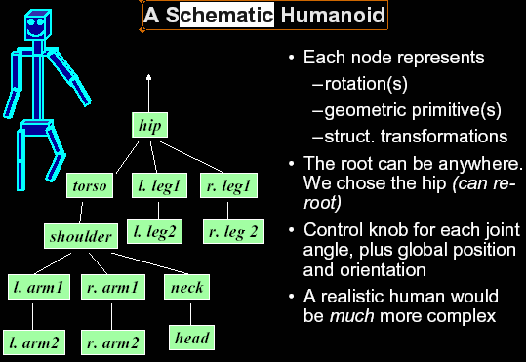
Graphical Data Structure

Slide 19
Graphical Data Structure
Basic Data Structures for Graphics
Static Array
Homogenous data structure
DIMENSION REALARRAY(100) FORTRAN
a = array[1 … 100] of real PASCAL
float a[100]; C
Operations: Traversal , Insertion, Deletion
Description of objects with vertices can be represented with an array for cubes
Structured Data types
A structure combines other data types
in Pascal its called Record
in C its called Struct
Struct A{
data_type 1 var1;
data_type 1 var1;
-------------
} ;

Slide 20
Graphical Data Structure
struct point{
float x,y.z;
} ;
struct edge{
struct point v1, v2;
} ;
struct object{
int no_of_edges , no_of_vertices, no_of_faces;
struct point vertices[100];
struct edge edges[100];
int faces[100][100];
} ;

Slide 21
Graphical Data Structure
Pointers
Used to effectively represent complex data structures and to deal more consicely with arrays
struct edge{
struct point *pv1, *pv2;
}e1 ;
e1.pv1 = &v1;
e1.pv2 = &v2;
Linked Lists
It is a collection of data elements or nodes pace in a linear order by pointers.

Slide 22
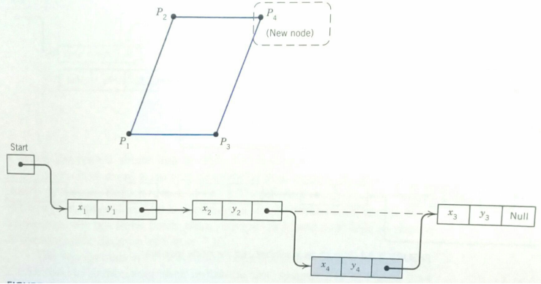
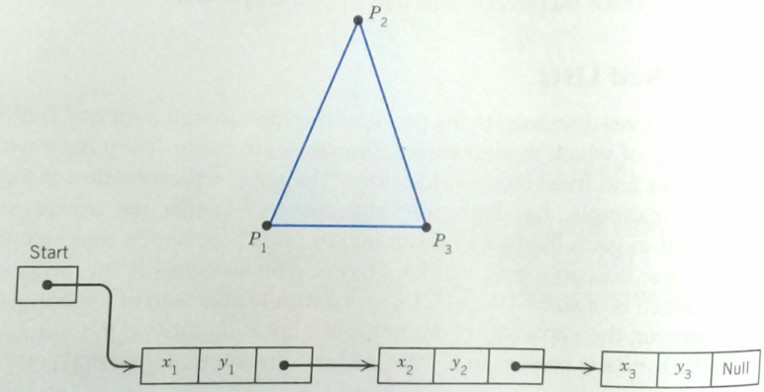
Graphical Data Structure
Linked list data structures can be used to represent object descriptions

Slide 23
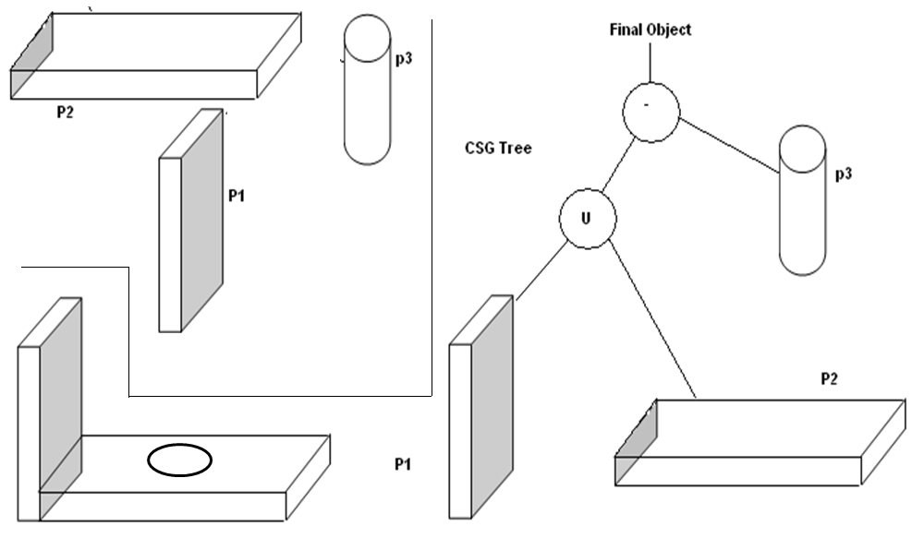
Graphical Data Structure
Tree It is a non linear data structure use to represent data having hierarchical relationship it contains a finite number of nodes and one root

